Slide 1
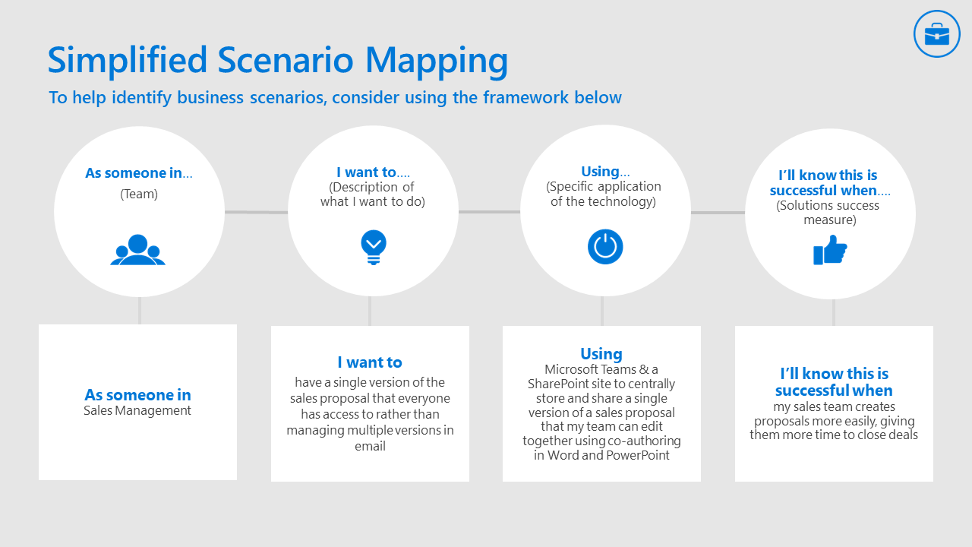
Scenario Mapping

Slide 2
Scenario
As someone in… (Team)
I want to… (Description of what I want to do)
Using… (Specific application of the technology)
I’ll know this is successful when… (Solutions success measure)

Slide 3
High Five - $24,640 savings per year
Business Need: Need to replace our third-party (Snow Fly) Rewards and Recognition tool due to high costs and limitations.
Solutions: Built a new solution in 24-hours using SharePoint to submit and store the “High Fives”, Power Automate to process and notify recipients and managers, and Power BI to report on total number of recognitions per department and per manager.
360 hours per year to administer Snow Fly - 52 hours per year to administer High Five solution X $80 per hour average wage with benefits $24,640 per year in savings (Not counting cost of Snow Fly)

