Slide 1
Train the Trainer - What to Use When
We will get started shortly!

Slide 2
Train the Trainer
What to Use When: OneDrive, Teams, and SharePoint
Future Proof Your Workforce and Secure End User Adoption with Evolve 365 from Planet Technologies
#EXPERIENCEMATTERS #GOPLANET

Slide 3
Agenda
Prepare your environment
Prepare your presentation
Review demos and deck
Promote your training
Running the webinar
Questions
Follow-up
The training deck

Slide 4
Prepare your environment
You will need to access your OneDrive
You will need access to a Team with Channels
Have access to a Chat in progress
You will need access to a SharePoint Team Site
Have a document library with documents in it

Slide 5
Prepare your presentation
Settings
Review the deck
Review the demos
Practice switching between applications
How to remove and add logos to the deck

Slide 6
Settings – Turn on Presenter view
Presenter view requires two screens
Notes:
If you have two monitors, use Presenter View.

Slide 7
Settings – Turn on Presenter view
Presenter view requires two screens
Notes:
Go to the Slide Show tab.

Slide 8
Settings – Turn on Presenter view
Presenter view requires two screens
Notes:
From the Monitors group select Automatic for Monitor
Check the box for Presenter View.

Slide 9
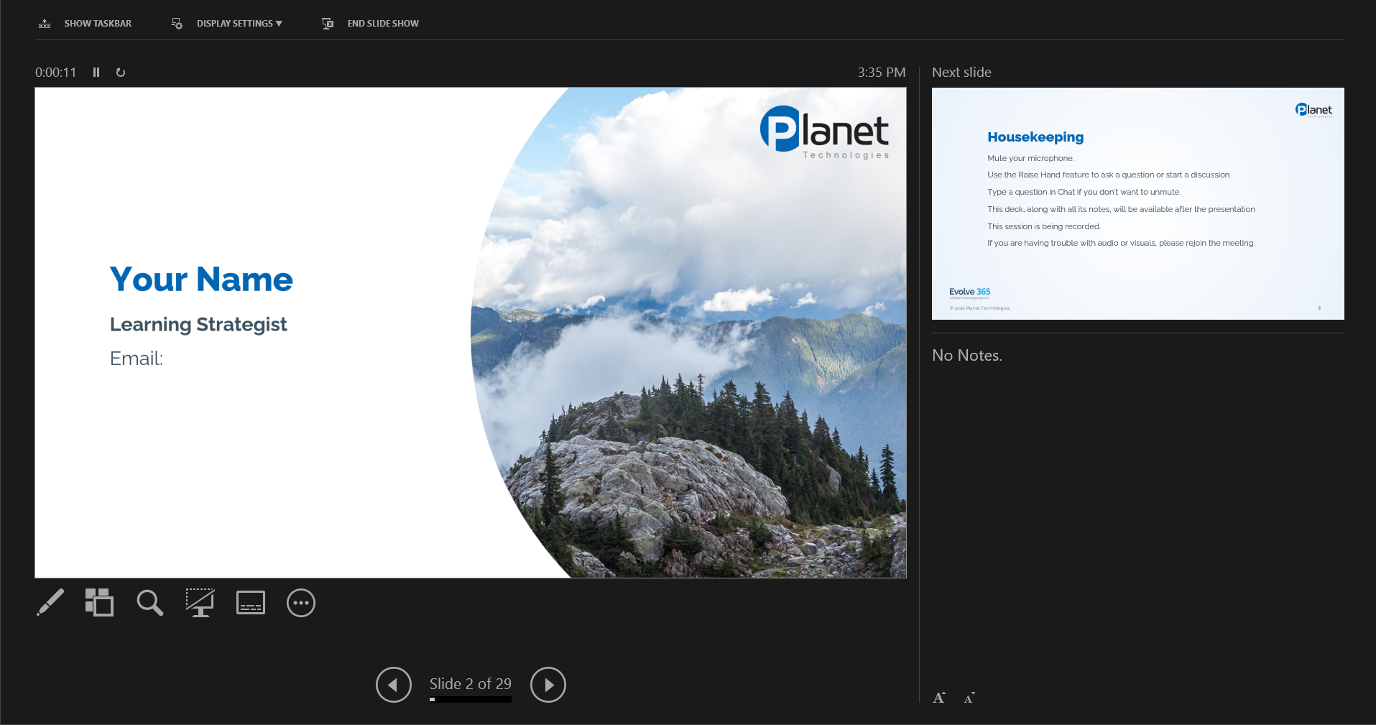
Notes:
Presenter view
One screen will show the presentation in Slide Show mode.
The other screen shows the current slide (large), the notes for the current slide, and the next slide (small) in the deck.
Use the arrows at the bottom of the small screen to advance the slides.
To end the presentation, click on the three dots below the current slide on the small screen and select End show.

Slide 10
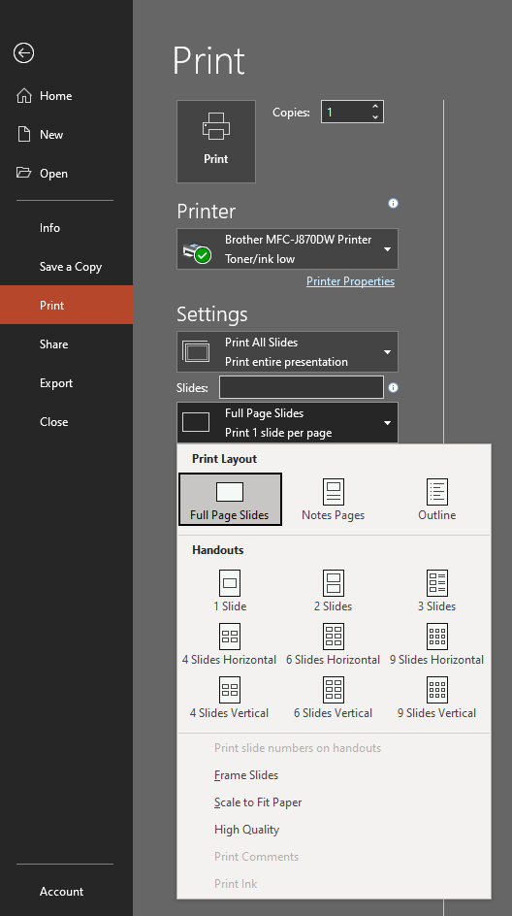
Settings – Note slides
Go to the File tab.
Select Print.
Notes:
If you don’t have two monitors, print off the Notes slides.
Go to the File tab.
Select Print.
Under Settings, change Full Page Slides to Note Pages.
Select your printer.
Select Print.
You now have the full deck printed out with the notes for each slide.

Slide 11
Settings – Note slides
Go to the File tab.
Select Print.
Under Slides, change Full Page Slides to Note Pages.
Select your printer.
Select Print.
Notes:
Under Slides, change Full Page Slides to Note Pages.
Select your printer.
Select Print.
You now have the full deck printed out with the notes for each slide.

Slide 12
Review the deck
Run through the training deck in Presenter view.
Review and update the notes as needed.
Make it sound like you.
This is your presentation.

Slide 13
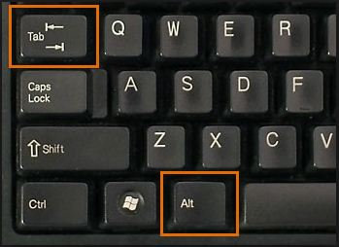
Moving between PowerPoint and Demo
Practice switching between your deck and your demo environment.
Use ALT + Tab to show all open applications.
Use the Tab key to move from application to application.
The white outline indicates the selected application.
Release ALT to select an application to show.
Notes:
Make sure to close all unnecessary apps before the webinar. This includes closing Outlook.

Slide 14
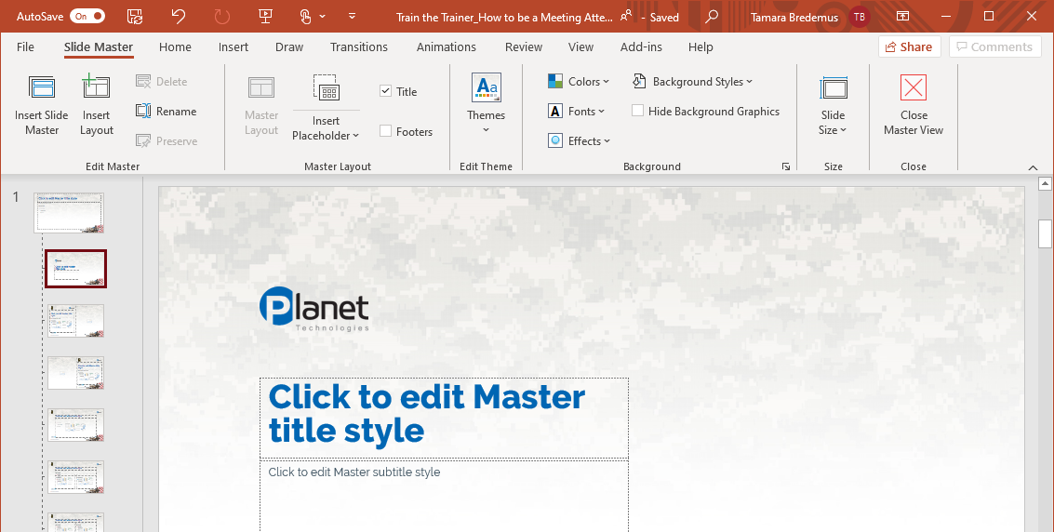
How to remove and add logos
Notes:
Save a copy of the PowerPoint presentation to your OneDrive or another location.
Open the saved copy.
Select the View tab.
In the Master Views group, select Slide Master.
Scroll up on the list of slides until you are at the top.
Select the logo to remove and press the delete key. This will remove the logo from all slides.
To add a logo, copy and paste the picture to the Master Slide and position it as you like. This will add the logo to all of the slides.
When you are done making your changes, select Close Master View.

Slide 15
Promote Your Training
Invite people to training
Send prepared email
Post to Teams

Slide 16
Invite people to training
Create the invite in the environment you will do the demos in
Add people or a Teams Channel to the invite
Copy the Join the Meeting link for posting in email and Teams Announcements
Notes:
Instructions on how to create a Teams meeting are in the notes section of this slide.
In Teams, in the app bar, select Calendar.
In the upper right corner select +New meeting.
Title the Meeting: Organize Your Information in Teams Webinar.
Invite attendees by name or Add a channel.
Set the start date and time.
Set the end date and time (30 minutes after the start time).
Put the description of the webinar in the Details box.
Select Send in the upper right corner.

Slide 17
Send an email
Create the Word document
Include Title, Description, Date & Time (with time zone), and Join Meeting link
Open Outlook
Paste Word document into email
Add potential attendees to the email
Send the email

Slide 18
Post to Teams
Create an Announcement in a Channel an hour before the webinar
Use a banner (918px X 120px) to draw attention
Include in the Announcement
Name of the webinar
@mention the Team
Date and time (include time zone)
Topic
Training level
Description
Notes:
Instructions on how to create an Announcement are in the notes section of this slide.
Navigate to the channel where you’d like to make the Announcement.
At the bottom of the screen, select New conversation.
Select the Format icon (the A with a paint brush).
From the New conversation drop-down, select Announcement.
If you would like to add a banner, select the Picture icon in the headline.
From the Add a background image window, select Upload an image.
Browse to where you stored the Announcement banner from the Training Box.
Select the banner.
Select Open.
Select Done.
In the headline type the name of the webinar: Organize Your Information in Teams Webinar.
In the subhead type the date and time of the webinar. Make sure to include the time zone.
In the Type your announcement section add the webinar description: In this 30-minute webinar, attendees will learn how to organize their Teams environment, files, and communications. A place for everything and everything in its place.
Press the Enter key.
Add the link to the webinar.
Press the Enter key.
Type @Team and select the channel or Team you are in, then add, bring a friend or two to the webinar. This will alert everyone in the channel that the webinar is about to begin.
Select the Send icon in the lower right of the Announcement window.

Slide 19
Running the webinar
Mute all
Remove attendee
Raise hand
Monitor chat
Reactions
Bring a buddy
Questions

Slide 20
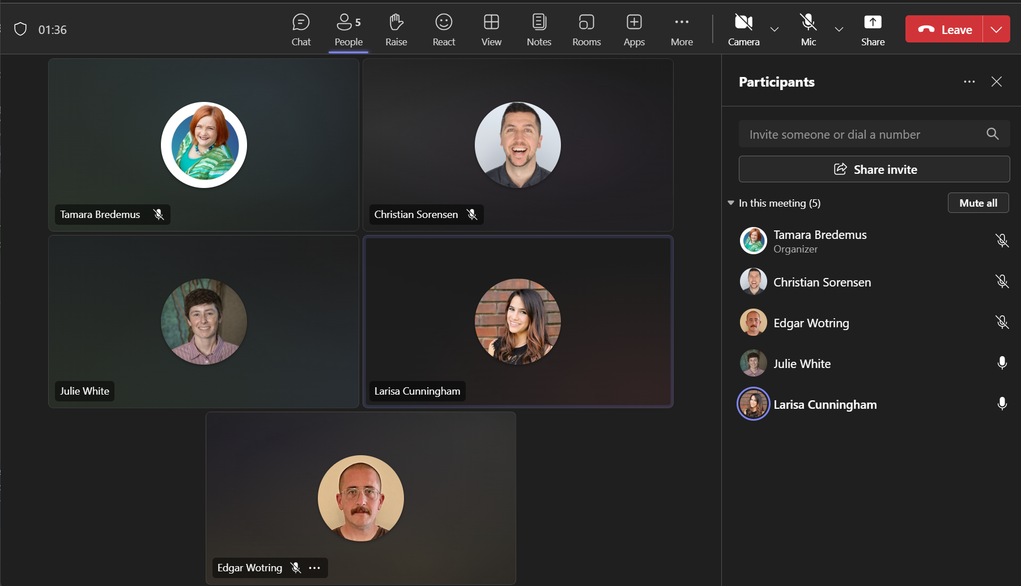
Mute all
You must have at least two people in the meeting for Mute all to show up.
Notes:
If people have their mics on and the background noise is too much, consider muting all participants.
To Mute all, select the Participants icon in the meeting toolbar.
In the Participants pane, select the Mute all button.
All attendees are now muted.

Slide 21
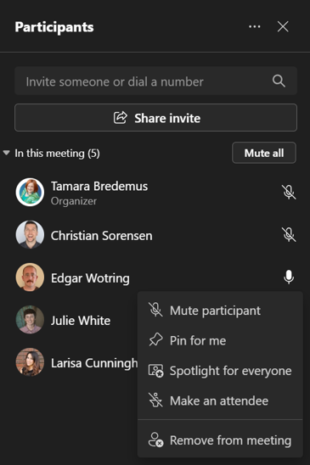
Remove attendee
If a person continues to be disruptive, consider removing that attendee.
Notes:
To remove an attendee from the meeting, select the Participants icon.
From the Participants pane, hover over the name of the attendee to remove.
Select the More options icon.
From the More options drop-down, select Remove from meeting.
The attendee is then removed from the meeting.

Slide 22
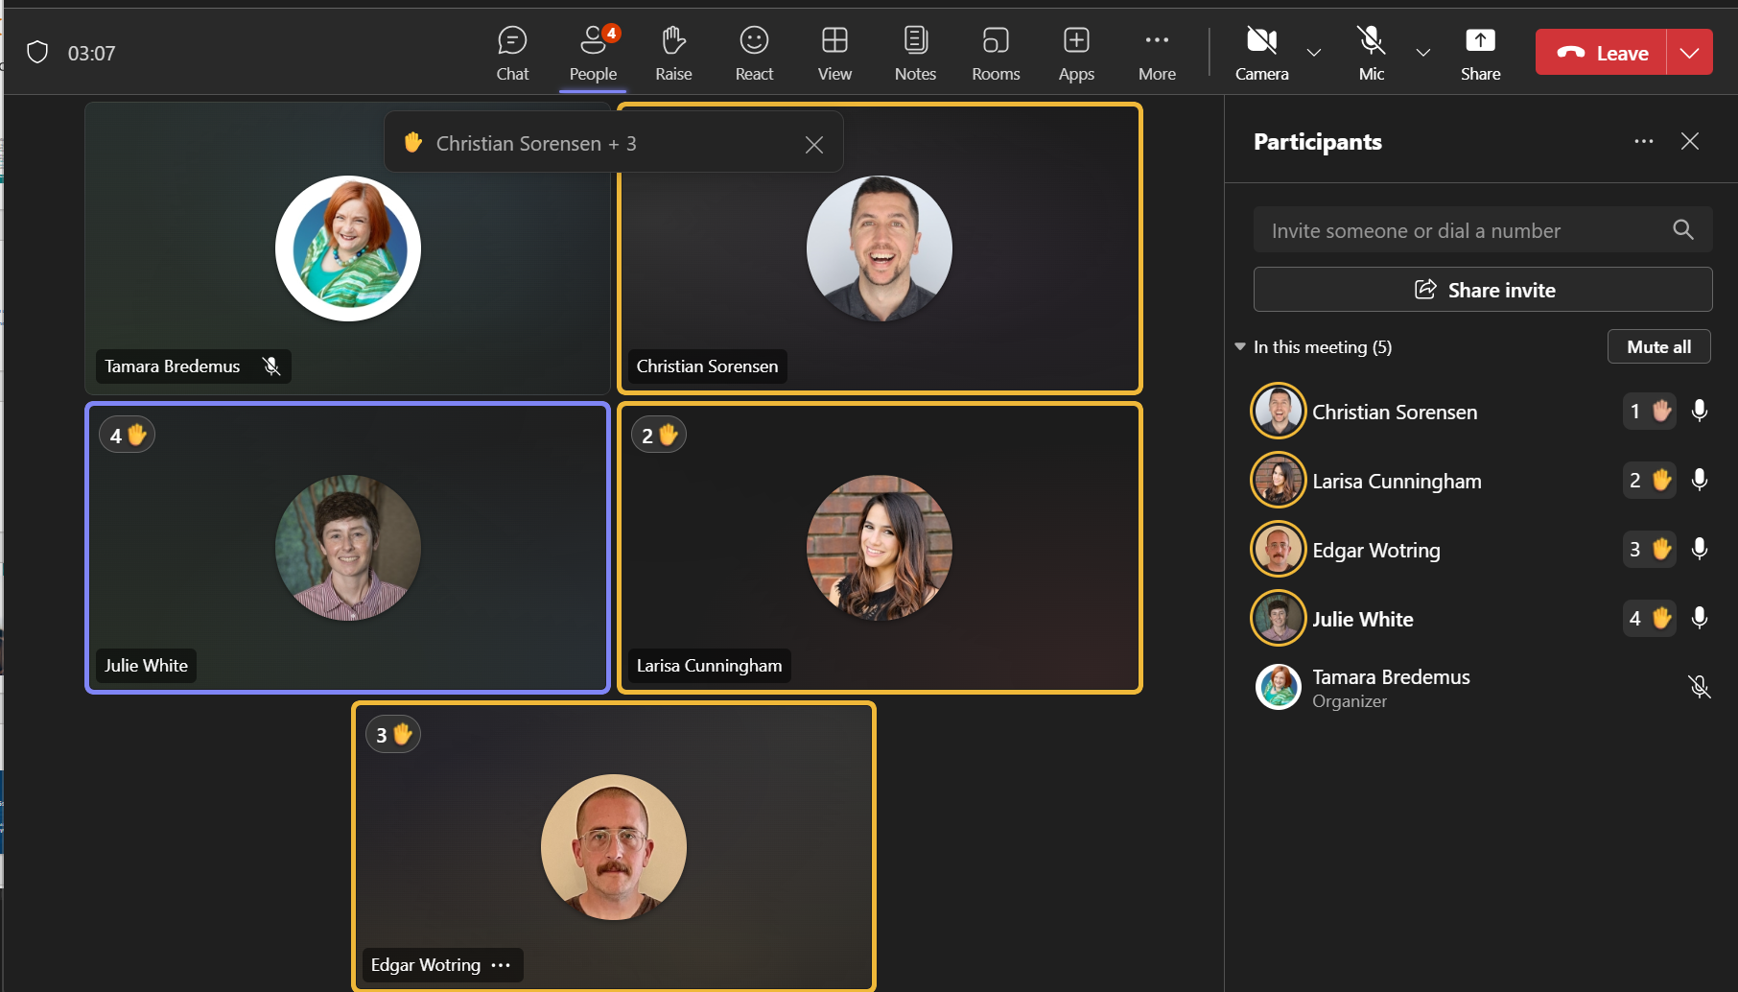
Raise hand
Instruct your attendees to use the Raise hand feature if they have a question or comment.
When the attendee selects the Raise hand icon, a hand appears next to their name in the Participants pane.

Slide 23
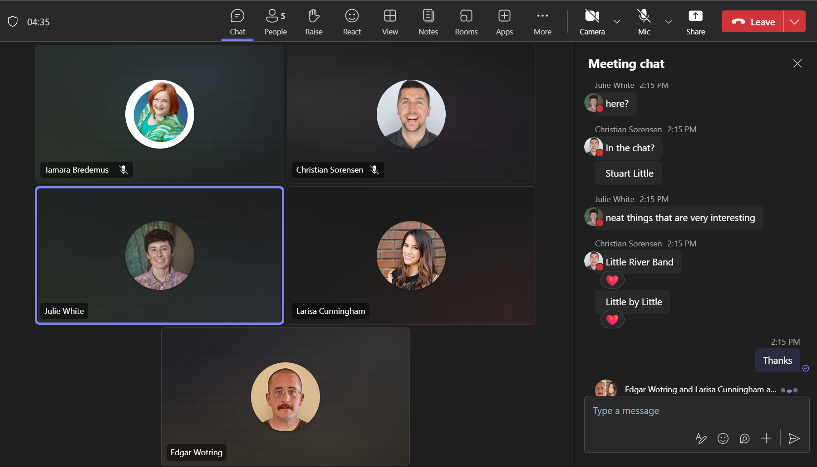
Monitor chat
Stop the presentation periodically and check the chat for questions or comments.
Notes:
To access the Meeting chat, select the Chat icon on the meeting toolbar.
The chat will appear on the right of the meeting screen.

Slide 24
Bring a buddy
When possible, ask a co-worker to moderate your webinar.
They can keep track of who raises their hands.
They can monitor the chat for questions.
This way you can focus on your presentation.

Slide 25
Questions
Try to take questions during the session.
Remember, there are no stupid questions.
If you don’t know, don’t guess.
Research the question and post the answer in the meeting chat.

Slide 26
Webinar follow-up
Evaluation survey
Thank you email

Slide 27
Evaluation survey
What percentage of information was new to you? 100%, 75%, 50%, 25%, 0%
I can use this session information: Immediately, In 2-6 months, In 7-12 months, Never
Please rate the speaker’s knowledge of the topic: Scale of 1 to 10 with 10 being the best
Overall session evaluation: Scale of 1 to 10 with 10 being the best
Notes:
An evaluation is optional. You don’t have to do this.
If you do want to do an evaluation, consider creating the evaluation in Microsoft Forms.
Office apps
Click the All Apps icon at the bottom of the navigation pane on the left.
Select Forms.
Select New Form.
Select Untitled form and type the title for your evaluation. Consider using the name of the webinar followed by the word evaluation.
Select +Add new.
Select Choice.
Type your question.
Type your Options for choices.
Repeat until all of your questions are added to the form.
Select the Share button in the upper right corner.
From the Send and collect responses drop-down select Only people in my organization can respond or Anyone.
Select Copy to copy the shortened URL to share with your attendees.
Share the link for the evaluation in the meeting chat during your webinar.

Slide 28
Follow-up email

Slide 29
Run through the deck and demos
Now it’s time to look at what to show your attendees

Slide 30
What to Use When
In this 45-minute webinar, attendees will learn how to determine where to store files and when to use OneDrive, Teams, and SharePoint.

Slide 31
Your Name
Title
Contact information
Your picture
Notes:
(Fill out your information on this slide. If you do not want to include your information, delete this slide from your copy of the deck.)

Slide 32
Agenda
Overview of OneDrive, Teams and SharePoint
How SharePoint & Teams work together
How OneDrive & Teams work together
When to use which tool
Notes:
In today’s session we will cover an overview of OneDrive Teams and SharePoint.
We will also look at how SharePoint and OneDrive work together in Teams
…and finally we will discuss when to use OneDrive vs Teams vs SharePoint.

Slide 33
OneDrive Overview
Storage for personal business files
Most organizations use OneDrive to replace personal network drives
Share with a few people
1 TB of storage
250 GB file size limit
Office.com
Sync to computer
Notes:
Storage for personal business files NOT project files, SOPs or documents you will need to refer to in 5 years. Because if you leave the Navy, your OneDrive files will disappear in 30 days. Your manager can request your file, but if they don’t do that within 30 days, those files are gone.
Most organizations use OneDrive to replace personal network drives NOT the Shared drives. Do NOT move your Shared Drives to your OneDrive.
By replacing the personal drives, organizations can reduce or eliminate the amount of local storage they need to manage
You have up to1 TB of cloud storage
You can upload files up to the 250 GB file size limit
You can get to OneDrive by going to Office.com and if you have you can sync your OneDrive to your computer. This will make the files available through File Explorer.

Slide 34
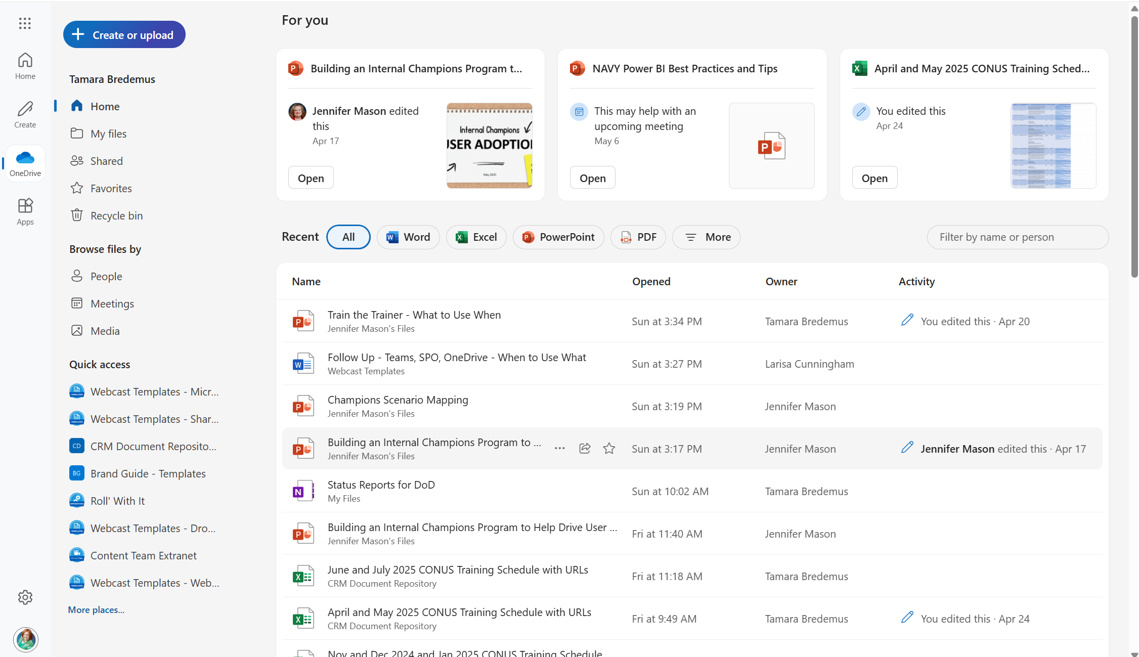
Notes:
This is what OneDrive on the web looks like
<CLICK> You may create or upload files or folders here.
<CLICK> Navigate through your Files, Shared files, things you have marked as a Favorite, and the Recycle Bin where you may recover files deleted from your OneDrive. By default deleted files are held for 93 days. CHECK WITH YOUR IT DEPARTMENT TO CONFIRM HOLD TIME.
<CLICK>Find files by People who have worked on the file, files that were shared in a meeting, and any media you have saved.
<CLICK> Quick Access allows you to access sites you have recently accessed.
<CLICK> For you is documents you and your partners have accessed.
<CLICK> Filter your files here
<CLICK> View your recent files

Slide 35
Demo
Let’s Take a Look
Future Proof Your Workforce and Secure End User Adoption with Evolve 365 from Planet Technologies
#EXPERIENCEMATTERS #GOPLANET
Notes:
Go to OneDrive On the web.
Explain the home page
Create or upload a file
Show Files
Share a file
Stop sharing a file

Slide 36
Microsoft Teams Overview
Up to 25,000 people
Connect with colleagues and information
Work effectively and perform at your peak
A chat-based workspace
Combines chat, documents, people, and tools in one secure place
Keep everyone up-to-date
Notes:
Up to 25,000 people can be in a Microsoft Team
Microsoft Teams is an entry point to the tools you need to connect with colleagues and information
Teams is a collaboration tool from Microsoft that brings together information that teams need to work effectively and perform at their peak
A chat-based workspace that combines chat, documents, people, and tools in one secure place
With Microsoft Teams, you can create a more open, digital environment that makes work visible, integrated and accessible across the team, so everyone can stay in the know.

Slide 37
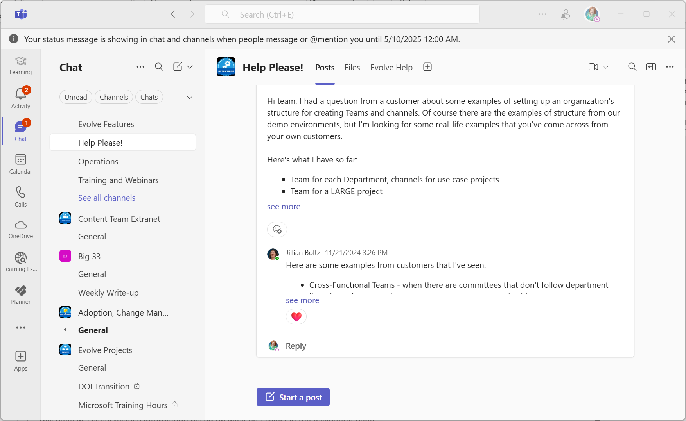
Notes:
You can access Teams through the desktop application or the browser. You can tell this image is from the browser because the application waffle is located in the upper left corner.
The navigation pane
This pane will show relative information based on what you select in the navigation pane
Search works across all Teams to which you have access. Narrow down your Search results with filters
Add a Tab – Use Teams to create a one-stop-shop for your users by adding tabs to different applications and documents.
The Canvas – Where you will interact based on the item you selected in the navigation pane.
Profile – This is where you can change your settings like your presence indicator, your Status Message and your Notifications.

Slide 38
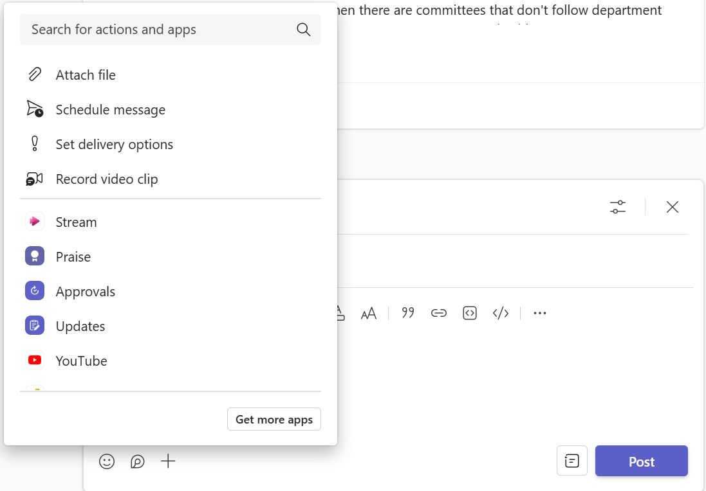
Attach Files to a Chat
Select the plus icon
Select how to upload file
Select file and click Open
Your file will show in the chat
Type a message
Check permissions
Click send
Notes:
In a Teams Chat, select the attachment icon under the ‘Type a new message’ area
Browse for your file and select ‘Open’
Your file will show in the chat pop up
Type a message if you’d like and click the send icon that looks like a paper airplane.
You can manage this file in OneDrive for Business in the “Microsoft Teams Chat Files” folder

Slide 39
Differences Between Posts & Chats
Teams Channel Posts
Part of a Team, all team members can view and contribute
Files attached to a post are stored in the SharePoint library associated to the Team
Posts have a reply option to help keep information about one post together
Ongoing conversations about a project or team related topic
Teams Chats
Not part of a team, only members of the chat can view or contribute
Files attached to a chat are stored in OneDrive for Business and shared with members of the chat
Chats are persistent threads with no reply feature
Pop-out feature
One off conversations
Notes:
Read the slide

Slide 40
Demo
Let’s Take a Look
Future Proof Your Workforce and Secure End User Adoption with Evolve 365 from Planet Technologies
#EXPERIENCEMATTERS #GOPLANET
Notes:
Show the following:
The navigation pane
This pane will show relative information based on what you select in the navigation pane
Search works across all Teams to which you have access. Narrow down your Search results with filters
Add a Tab – Use Teams to create a one-stop-shop for your users by adding tabs to different applications and documents.
The Canvas – Where you will interact based on the item you selected in the navigation pane.
Profile – This is where you can change your settings like your presence indicator, your Status Message and your Notifications.

Slide 41
SharePoint Online Overview
Share with up to 2 million people
SharePoint Online is a cloud-based service
Access internal sites, documents, and other information from anywhere
Navigate to SharePoint from Office.com
Sites that you follow
Manage files
Manage data
Use unique permissions
Notes:
Share with up to 2 million people
SharePoint Online is a cloud-based service that helps organizations share and collaborate with colleagues, partners, and customers.
With SharePoint, you can access internal sites, documents, and other information from anywhere—on a GFE or personal device with CAC.
When you navigate to SharePoint by going to Office.com you will have access to all the sites that you follow.
In SharePoint you can manage files, data and business processes.
Use unique permissions to secure files and data appropriately. Control who can edit and who can read your files and data.

Slide 42
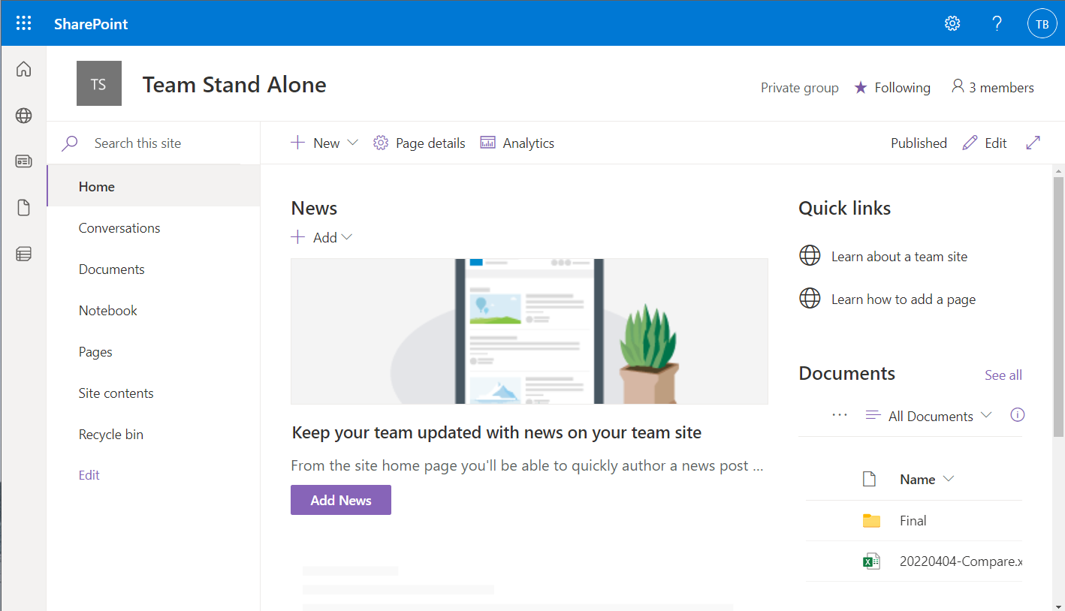
Notes:
This is a SharePoint site made with a Team site template. Not to be confused with Microsoft Teams. Notice that the navigation goes down the left side of the screen.
This type of site is used for managing work in progress and creation of documentation.
You can automate business processes using Power Automate.

Slide 43
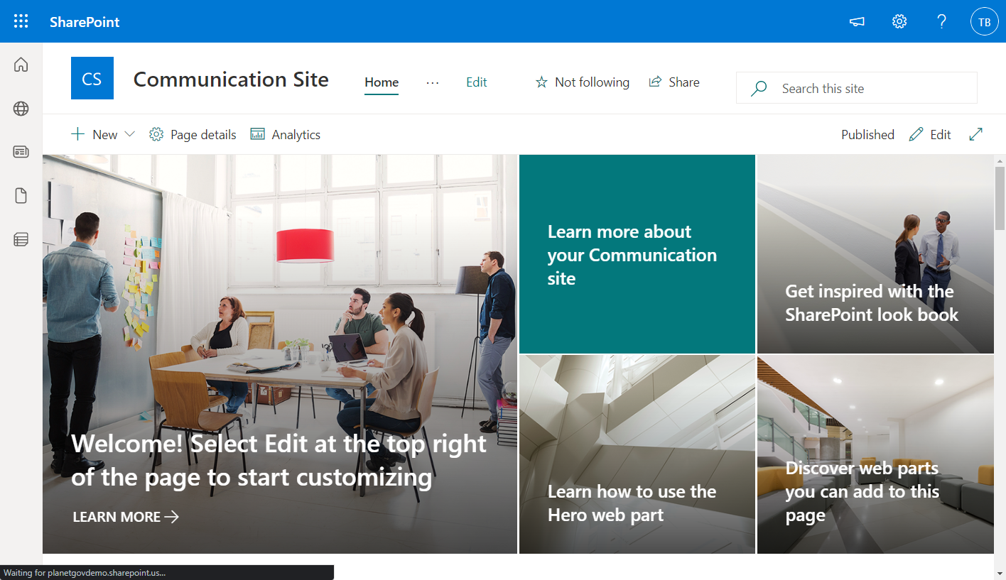
Notes:
This SharePoint site uses a Communication site template.
Notice the navigation across the top of the site.
This type of site is used to communicate ready for prime-time information like: What can your group do for the rest of the Navy
Standard operating procedures
Project artifacts

Slide 44
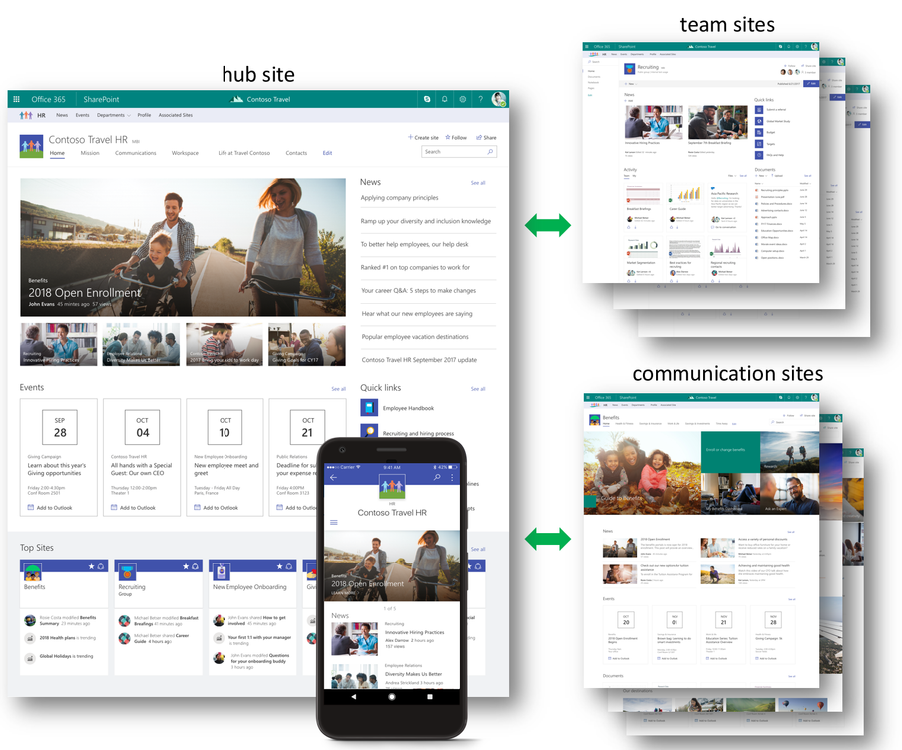

Slide 45
Demo
Let’s Take a Look
Future Proof Your Workforce and Secure End User Adoption with Evolve 365 from Planet Technologies
#EXPERIENCEMATTERS #GOPLANET
Notes:
Go to the Landing page for SharePoint and search for a term

Slide 46
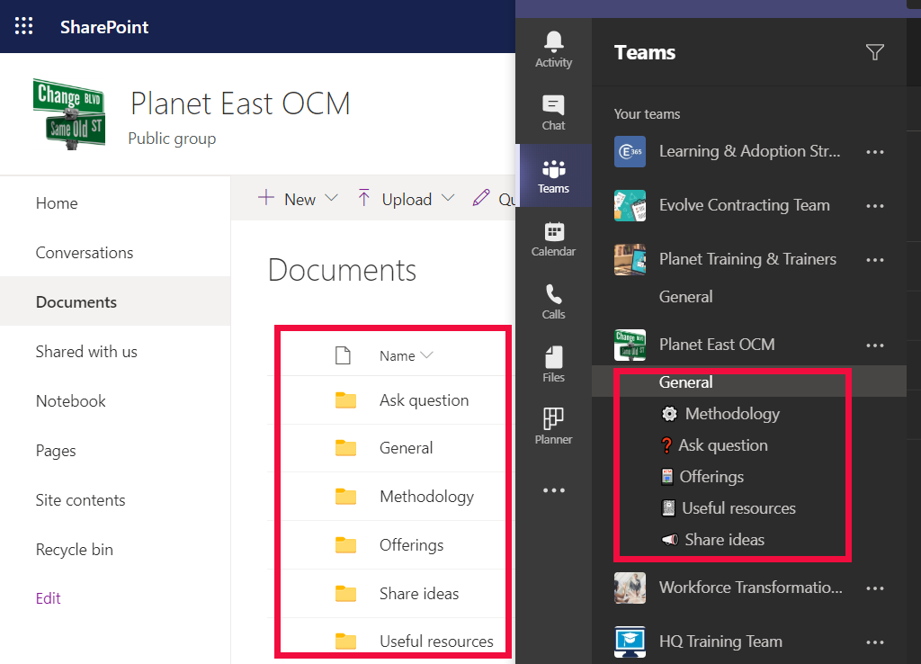
SharePoint & Teams Connection
SharePoint stores Team files
Documents is the name of the library
Each channel has a folder in Documents
Click Open in SharePoint for robust features
In Channels
Notes:
A SharePoint Online site is on the back end of every Microsoft Team, helping you manage and organize your channel files.
Each channel within a Team has a corresponding folder in the Default SharePoint library called “Documents”.
You can open the files area for any channel in SharePoint to view more robust document management options like Version History.

Slide 47
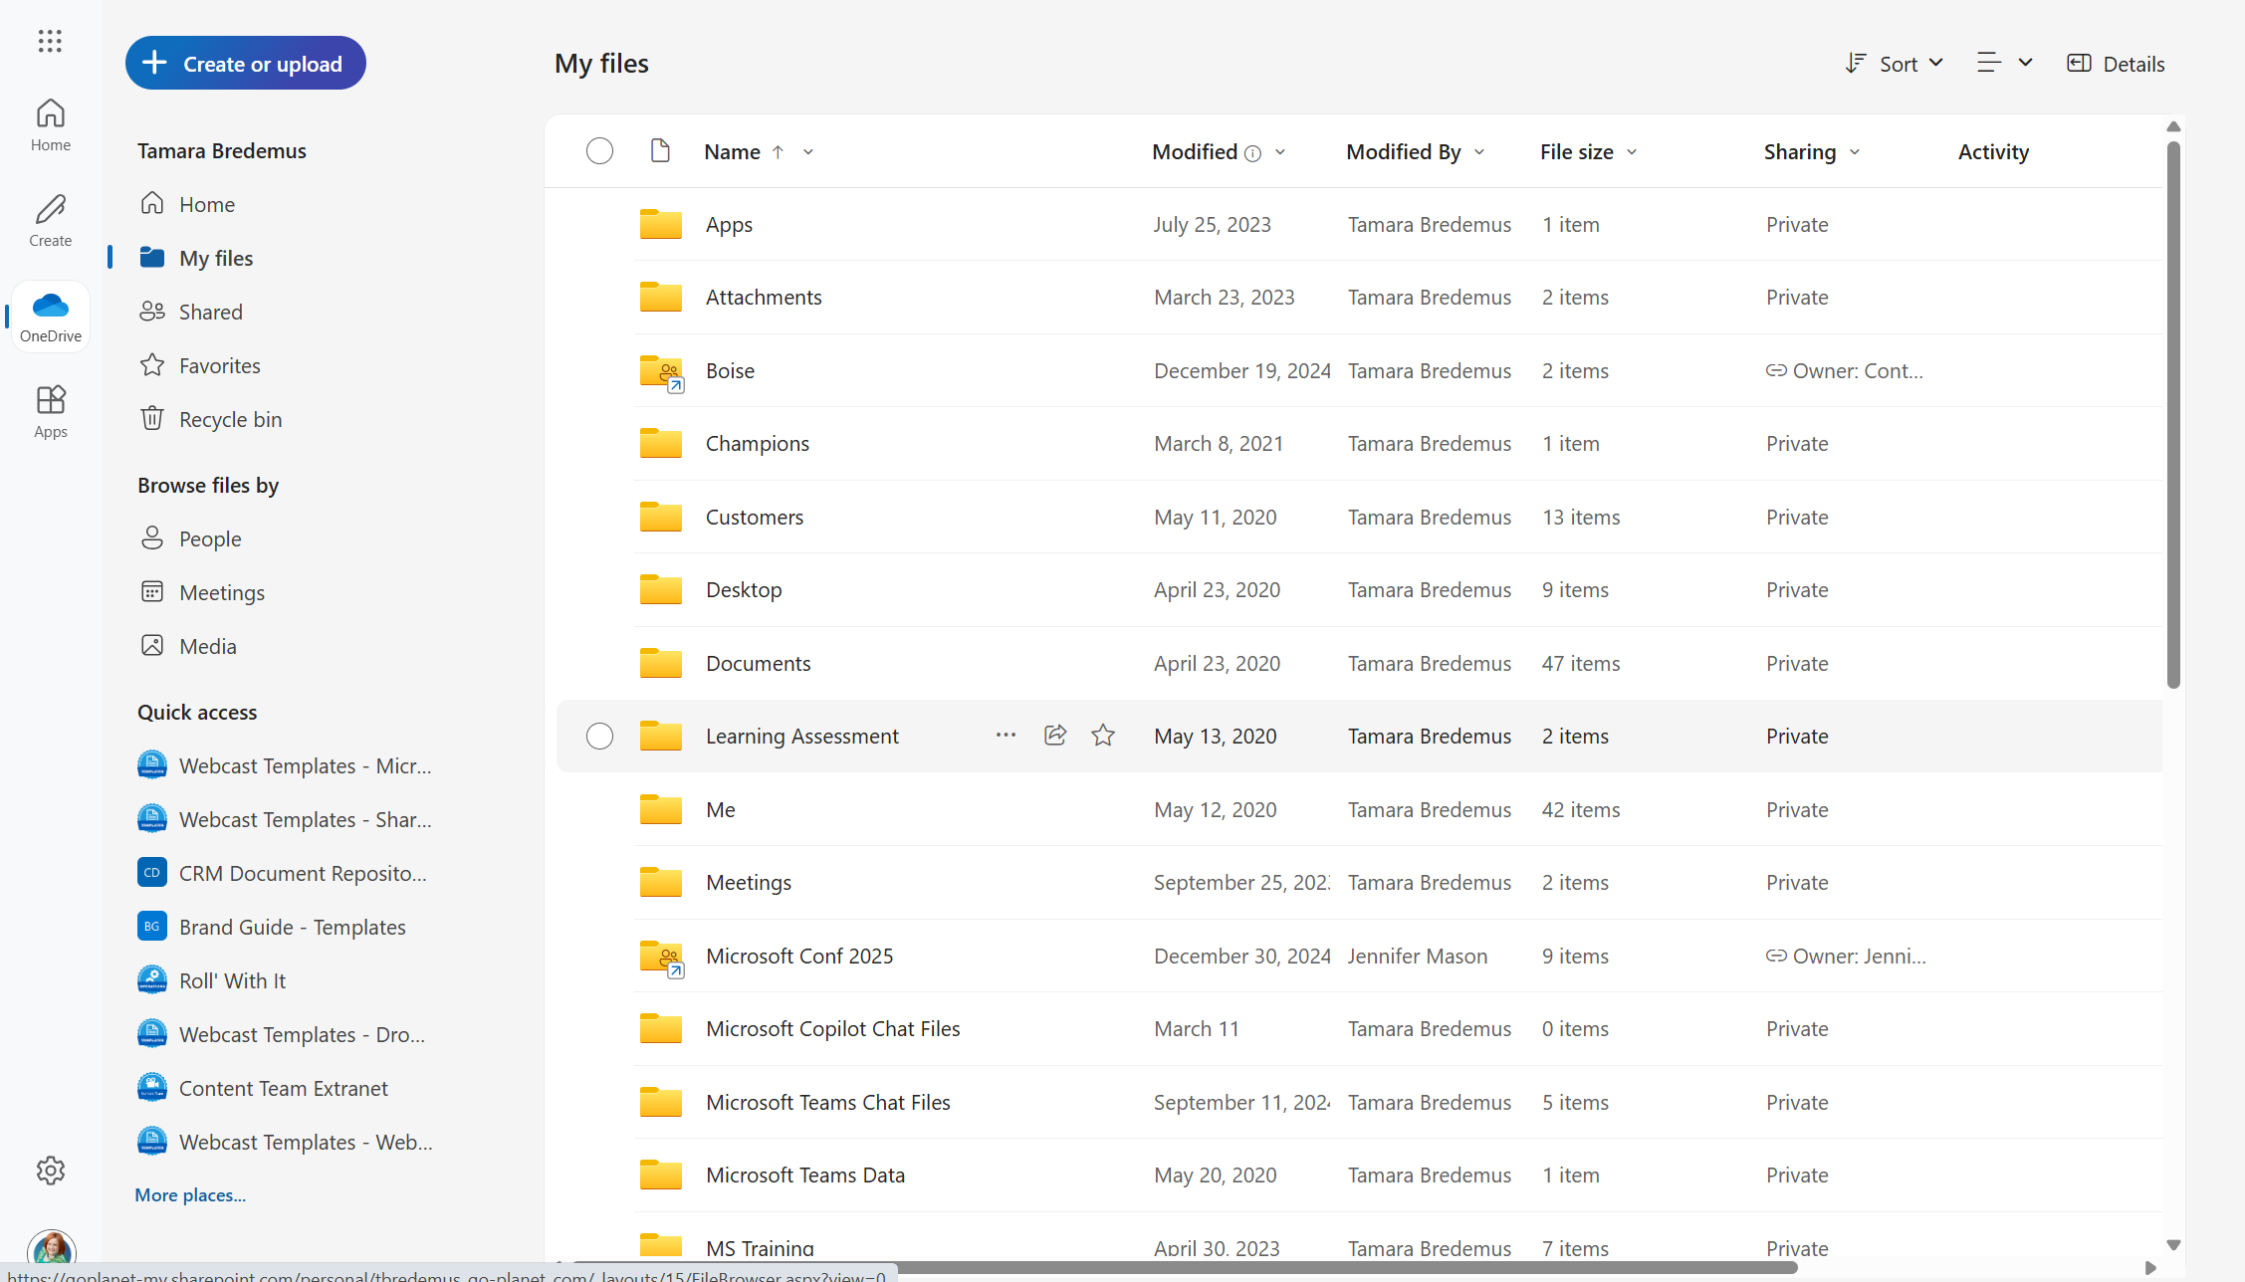
OneDrive & Teams Connection
Files shared in Chat are stored in OneDrive
Chat files found in Microsoft Teams Chat Files folder
People in the chat have edit access to the file
Manage document permissions through OneDrive
In Chats
Notes:
Files attached to a Teams chat are stored in OneDrive and shared with members of the chat.
You can find documents attached to chats in OneDrive in the ‘Microsoft Teams Chat Files’ folder.
Manage permissions to files you have shared with others through a Teams chat in OneDrive.

Slide 48
Individual STORAGE Team-level STORAGE Organization-level STORAGE
Create Connect, Collaborate Showcase, share, story
OneDrive
My Stuff
Your private working space that remains private until you share things
What is stored here?
Personal business files
First drafts that are not ready to be shared or collaborated on
Files to share with a few people
Stored in the cloud
What is posted here?
Not applicable
Teams
Team Stuff
Small(er) groups of people usually all with edit permissions
What is stored here?
Working docs for collaboration and edits; team storage and file sharing
What is posted here?
Real-time questions you want engagement on
Announcements, information, or meeting details with a quick turnaround
SharePoint
Everyone’s Stuff
Large(r) groups of people usually read-only permissions for most of them
What is stored here?
Long-term guidance and templates
Automated workflows
What is posted here?
More detailed and accessible long-term content
Content is searchable (using metadata / tags) and curated (version control)
Announcements live in a specific location on the portal landing page
This is where we transition away from H:, C:, and P: drives. And your desktop!
This is where we collaborate
This where we share and target information exchange
Notes:
This is a great slide to print off and have at your desk.
OneDrive is meant to one person and that person is you. You can share with a few people one-by-one. This is the place for your rough drafts and yearly job appraisals.
Teams is meant for up to 25,000 people to edit documents, virtually meet and chat with eachother.
SharePoint can be used to share ready for prime-time information to up to 2 million users OR Used to create and manage work product.

Slide 49
What did we learn
OneDrive is for one person
Teams allows up to 25,000 edit, chat, and meet
Team is for in-progress files
SharePoint shares in-progress and final documentation with up to 2 million users
SharePoint can be used to manage work product and documents
When to choose which tool

Slide 50
Please fill out the evaluation
Add shortened URL
Add large QR Code

Slide 51
Questions
Your name
Your contact information
Training Portal: Enter training portal URL here
Center of Excellence : Enter COI URL here

Slide 52
Thank You
Phone
123-456-7890
Website
o365support.com
Email
o365support@go-planet.com
Office Address
123 Anywhere St., Any City

